Slide 1

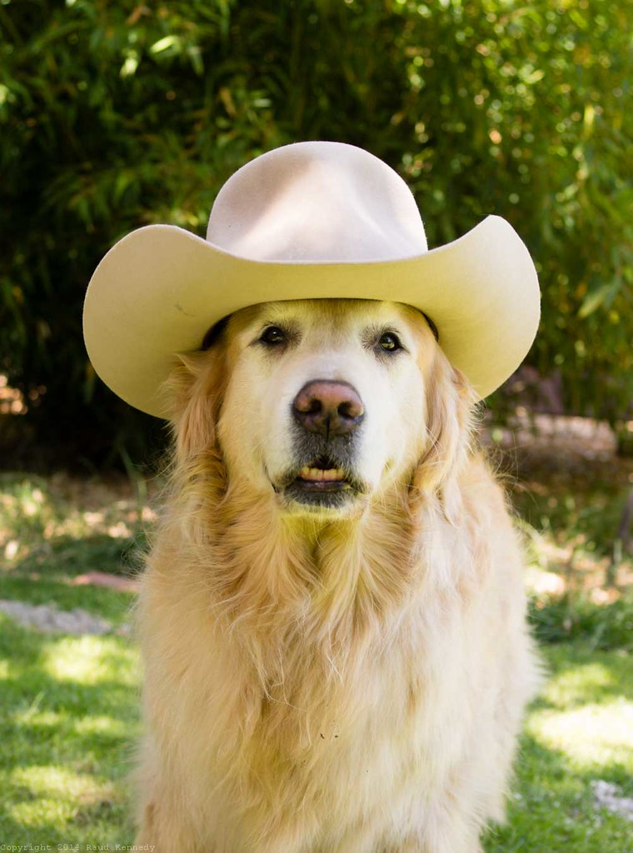
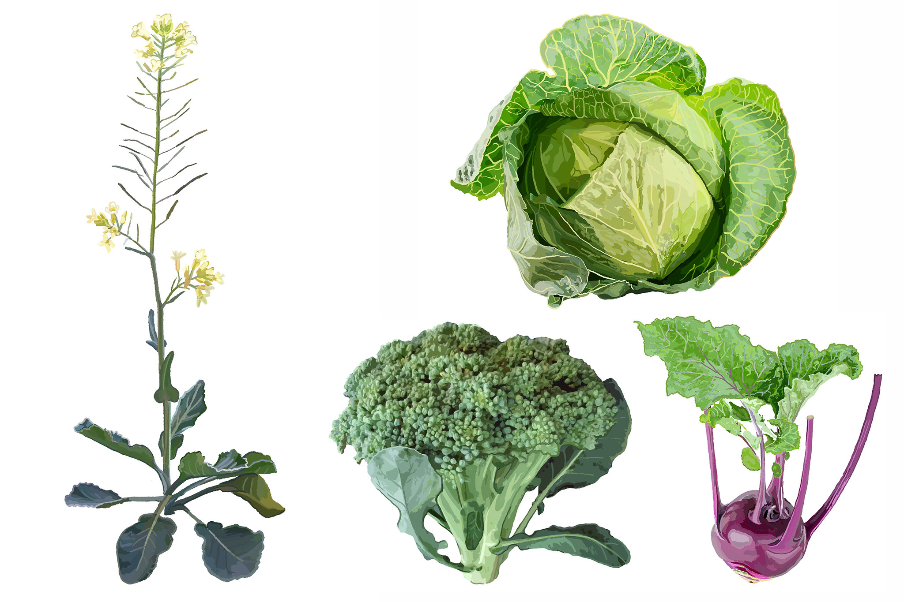
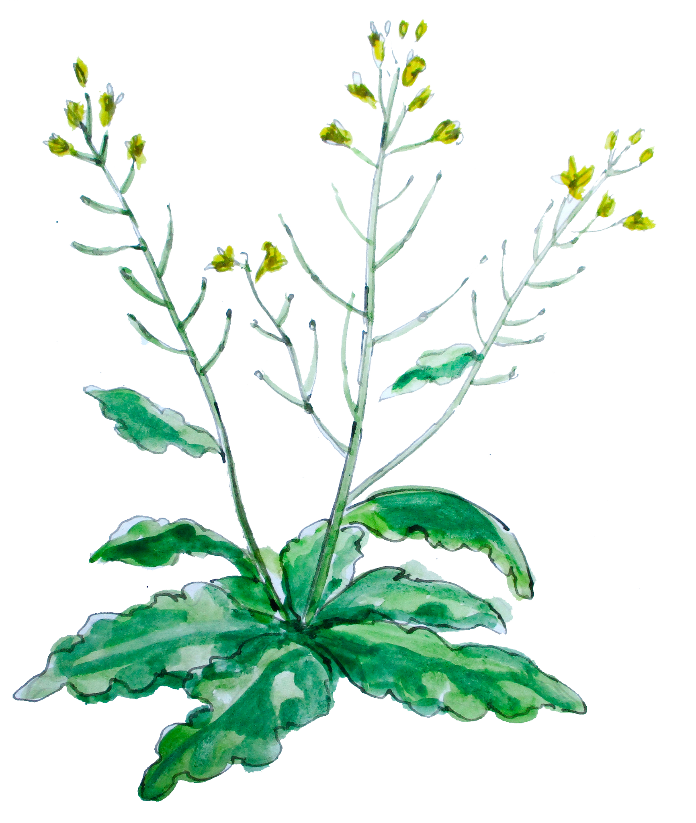

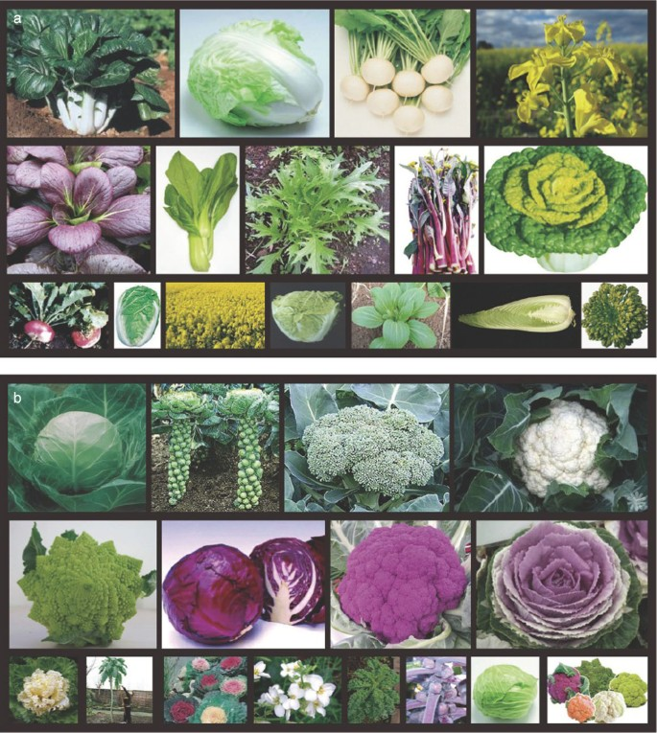
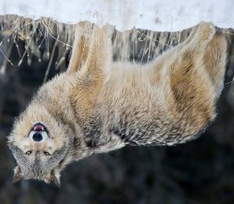
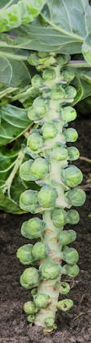
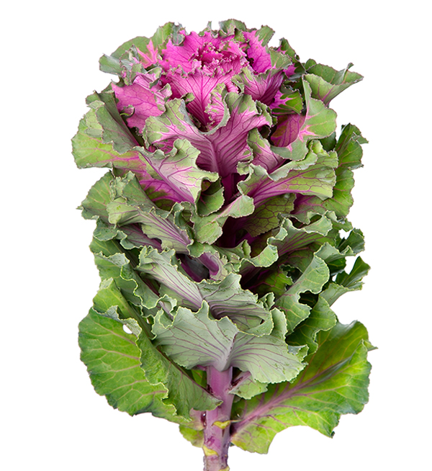
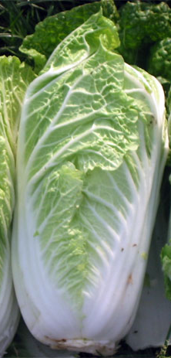
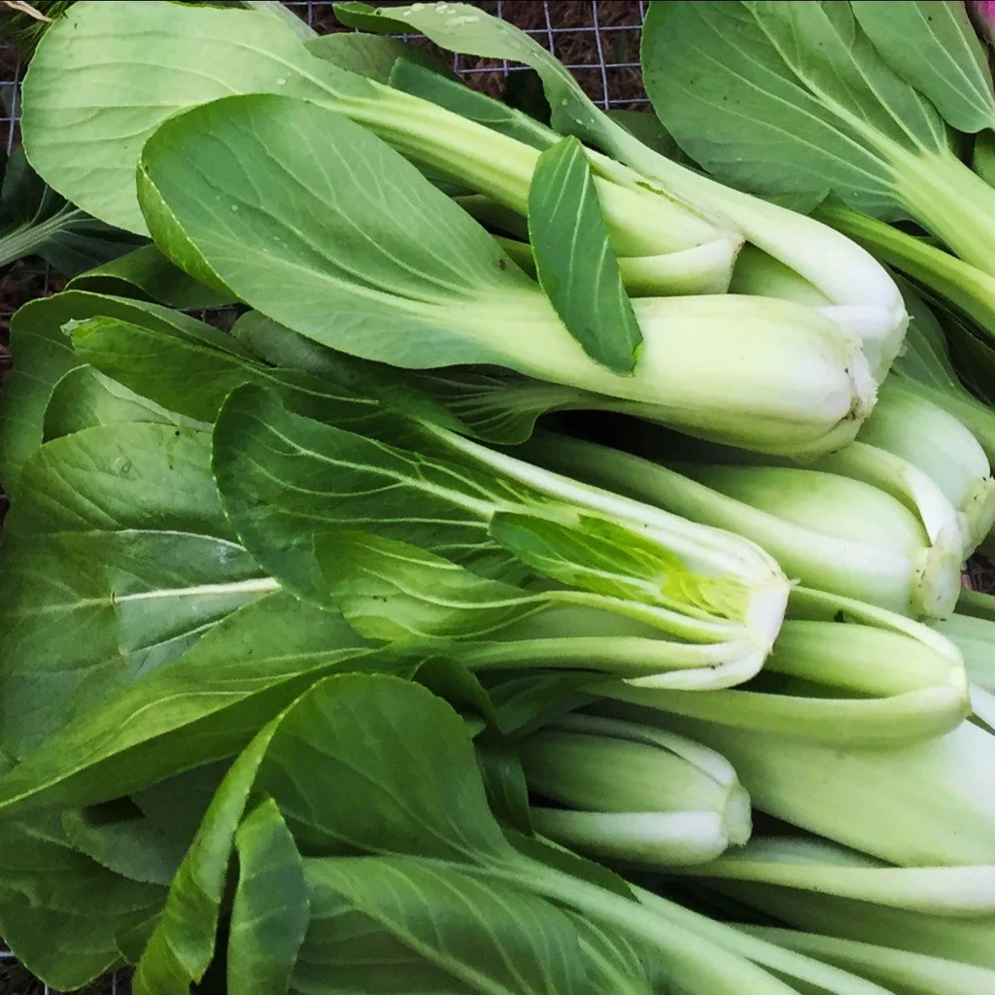
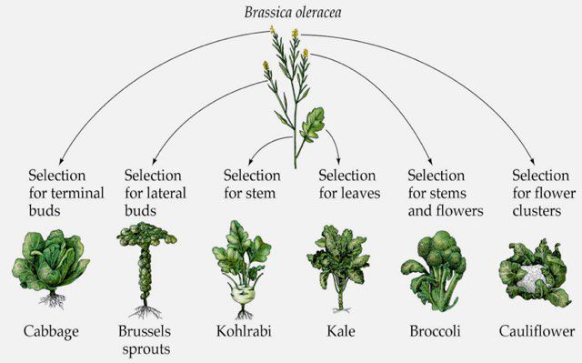
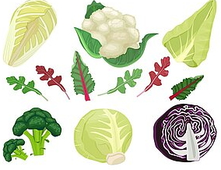
Brassica morphology (i.e. plant structure) is found in all cabbages.
Brassicas (or wild cabbage) were domesticated 3,000 years ago in Europe.
Since their domestication, plant breeders have created many different species within the genus Brassica
Like dogs, cabbages (genus Brassica) show great variability in their phenotypes (i.e. the observable characteristics).
Flowers (terminal buds)
Seeds
Flowers (lateral buds)
Stem
Leaves
Roots
Dogs were domesticated from grey wolves 15-25 thousand years ago. They vary in size, shape, and coat color.
Selection on different morphology components of Brassicas lead to many kinds of cabbages and their cousins
If you were a plant breeder, what kinds of Brassicas would you make?
Cabbages and their cousins:
The dogs of the plant world
Key Takeaways
This is only a small selection of the variety in the Brassica genus!
Follow up questions? Contact:
Merritt Khaipho-Burch: mbb262@cornell.edu

